Slide 1
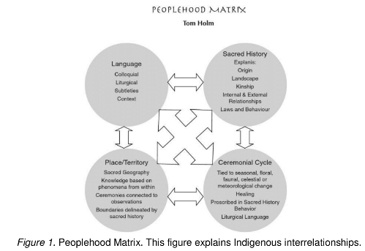

Slide 2
Relational Processes
Decolonization, Resurgence
Relational Ways
Of Knowing
Embody place, people, values, identity, ancestors, Spirit, and how these inter-relate
“Self-in-Relation-to”
holistic approach
to learning

Slide 3
Land-based Learning as Indigenous Resurgence
A global literature on Indigenous research (Smith, 2012; Absolon, 2011; Gaudry, 2011; Kovach, 2009; Wilson, 2008) has grown alongside a literature interconnecting Indigenous methods, theories, and transformative pedagogies (Smith, 2003; Menzies, Archibald, Smith, 2004; Grande; 2008; Ormiston; 2013).
The literature marks an Indigenous return to land-based traditions founded on a growing understanding of loss through colonial dispossession, connected to education as “the transmission of knowledge about forms of governance, ethics and philosophies that arise from relationship on the land” (Wildcat et al., 2014, p. II).
Corntassel (2012) illuminates,
"if colonization is a disconnecting force, then resurgence is about reconnecting with homelands, cultures, and communities."

Slide 4
As cited in Whetung, 2015, A pedagogy of the land recognizes and respects that the land is a sentient being that has emotional, spiritual, and intellectual characteristics (Styres, Haig-Brown, & Blimkie, 2013, p. 37). If the land is recognized as a thinking and feeling being, then surely the land has an intricate history, as well as an abundance of stories and memories.
Who is the land?
Styres, S., Haig-Brown, C. & Blimkie, M. (2013). Towards a Pedagogy of Land: The Urban Context. Canadian Journal of Education, 36(2), 34-67.

Slide 5
Land informs pedagogy through storied relationships. These stories are etched into the essence of every animal, rock, tree, seed, pathway becoming roadway and then city street, and every waterway—whether flowing free or trapped in a culvert somewhere under the city—in relation to the Aboriginal people who have existed on the land for generations. (Styres et al., 2013, p. 52).
Story as Pedagogy
Styres, S., Haig-Brown, C. & Blimkie, M. (2013). Towards a Pedagogy of Land: The Urban Context. Canadian Journal of Education, 36(2), 34-67.

Slide 6
Story serves to …
Name
Origin myths
sacred histories
Inter-personal relationships
Landscapes
Kinship
Laws and behaviors
Connect
Who we are in all of our inter-relations
With Spirit
As or with place
Teach
Process-oriented “Living Stories”
Told when appropriate
Connects people to place

Slide 7
Land-based Learning Practices
Land-based learning practices and engagements serve to ground the conceptual “book” learning in an experiential context infused with an Indigenous worldview.
As a framework for community engagement and inter-generational ways of knowing, it connects students with Knowledge Holders as sources of knowledge, learning and mentorship.
Land-based learning experiences also represent a specific experiential, holistic and affective domain learning process that emphasizes:
listening, honoring, values exploration, embodied knowledge and experience, community knowledge, self-reflective and peer reflective inquiry, and contemplative learning through connection to the land, people, song, story-telling and ceremony.

Slide 8
Traditional Land-based Learning Practices
Survival Practices
How to build fire, shelter & navigate terrain
Hunting Practices
How to track, fish, hunt, skin, trap
Cultural Practices
Erecting teepees, canoeing, curing meats, cooking meals, drumming, dancing
Healing Practices
Gathering medicines
Sharing stories
Infused with
story and Ceremony
Everyone Welcome:
Participants, relatives, children!

Slide 9
Place-based Learning
Indigenous Studies
Outdoor Tourism
Ecology (land, water, systems)
Research (community based)
Health and Mental Health
Inter-cultural Education
Teacher Education
Restorative Justice
Group and community building
Inquiry based learning
Experiential learning
Inter-generational learning
Embodied learning
Inter-cultural learning
Adventure learning

Slide 10
Discussion Questions
What aspects of land or place based learning would “fit” with your curriculum and instructional delivery?
How would you envision enacting a place-based learning event or having them participate in an Indigenous land based learning event?

Slide 11
Video Resources
Dechinta Bush Research Centre
https://vimeo.com/104060686
Grand Prarrie Regional College
https://www.youtube.com/watch?v=V8rI2Fqj98o

