Slide 1
Welcome Nursing Colleagues
Today we are going to …
brainstorm on what it takes to integrate a new educational technology
talk about ePortfolios
talk about advanced Moodle features
Facilitators:
Scott Gerrity & Susan Fleming

Slide 2
How can you ensure that an innovative educational technology hinders learning in your program? (make a list)

Slide 3
Faculty: Inconsistencies in Interpretation Implementation Inadequate training Lack of buy-in, poor attitude towards the technology Insufficient funding Lack of time to implement Insufficient resources to support adoption Doesn’t align with curriculum Time vs Utility Use advanced features Assume capabilities Language isn’t friendly Fixed platform (e.g. can only be used on a computer) Challenging Unique Overly innovative Lack of technical support No variety or flexibility Not housed in Canada No consultation prior to purchase Not user friendly Don’t ask for help Lack of testing prior to purchase | Students: Unclear instruction Insufficient support Assume capabilities

Slide 4
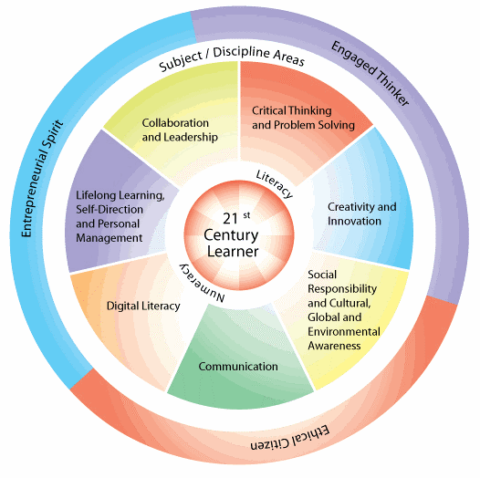
Time to Discuss (11 minutes) 1 minute to jot down ideas 2 minutes w/ a partner 4 minutes w/ your table 4 minutes w/ entire room

Slide 5
How are we going to stop doing these things? What are the next steps?
Evaluate technology Before, during & after purchase & implementation Ensure match between purpose & user Well developed, clear policy on use Schedule time to learn & implement – use PD time Consult experts Self-educate re education technology Don’t make assumptions Realistic goals & timelines Embrace change – good attitude Encourage buy-in Ask questions / be open Align with outcomes Adds value & supports objectives Appropriate level of technology Ask management for resources (including human) to support learning Mentorship Collaborate Ensure sufficient time to learn & implement Phased roll-out

Slide 6
Time to Discuss (11 minutes) 1 minute to jot down ideas 2 minutes w/ a partner 4 minutes w/ your table 4 minutes w/ entire room

Slide 7
What is an ePortfolio? What is an Artifact?
I think of artifacts as …
snapshots of “me” or “we” in action,
in the moment …
that help students build self-reflective capacity…
… and come to own their learning.
Notes:
Negotiation of meaning
We do not become fully human by ourselves

Slide 8
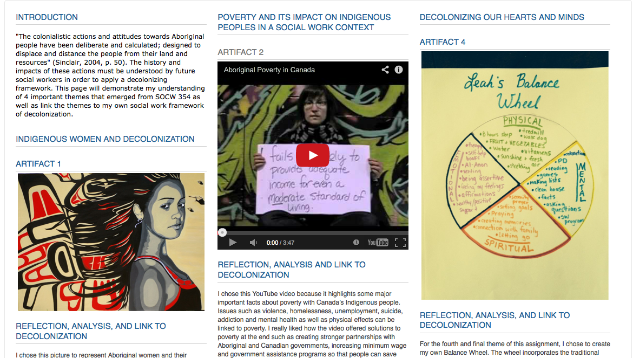
Notes:
relationship between self-reflection, iterative learning processes and multimodal learning.
The course concept she is exploring is decolonization across mulitple themes
--linkages between self-reflection, criticality and the course concept, as well as linkages across these themes in a non-linear fashion.
----Multimodality is evident in the use of text, image, video, creative drawing, and a non-linear representation.

Slide 9
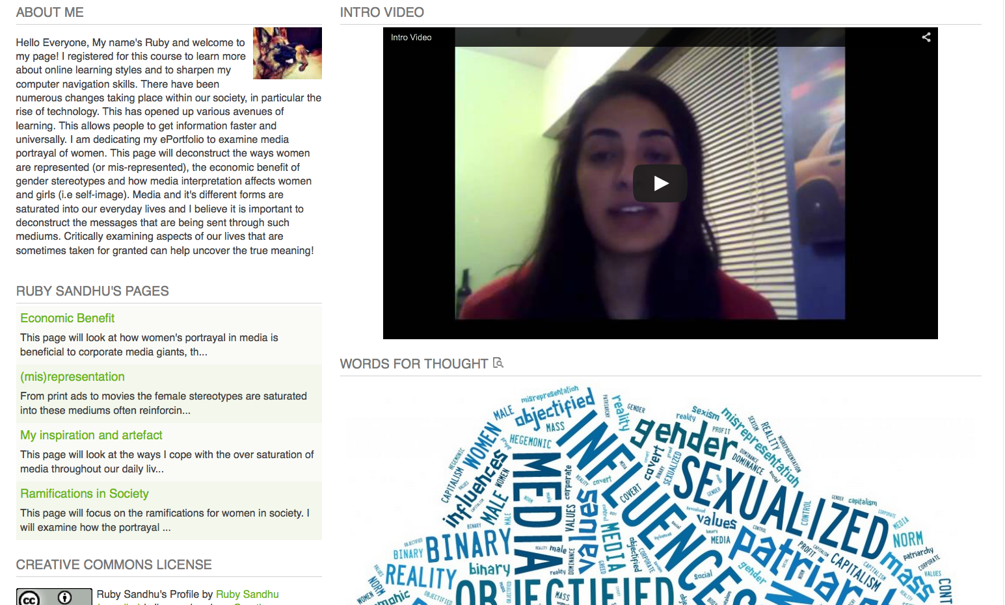

Slide 11
(My) Pedagogic Foundations for ePs
Negotiated
Choice & autonomy
(with accountability)
are integrated into curriculum.
How do I own my learning?
Builds for practice contexts
Facilitates learning as process
Engages through competencies
Best introduced 2yr and beyond
How do I relate to myself
and others?
To embody a
“Self-in-Relation-to”
holistic approach
to learning
Constructivist, Situated & Process-oriented
Students experience iterative cycles of building multimodal representations of learning
Relational & Transformative
Values, beliefs, inter-relations are explored through self-reflection on learning experiences
How do I come to understand my own learning process?
Notes:
I have used the eP pages to illustrate in concrete examples to illustrate what the principles presented here look like in practice.
--- I have contextualized in specific examples the design principles that
--- This diagram is both a model and a set of principles
---Negotiated curriculum … foundational principle, focused on personalized learning that builds towards ownership of learning
Options or choices, implicitly creates accountability in coming to own the choices they make
Builds around learning styles (how do I learn best?) in allowing choice.
Facilitation is about multiple roles… coordinator, resource provider, faciitator, administrator and teacher
---Constructivist, situated and process-oriented
1) Iterative process of engagement with course materials, concepts that become sitatuated within student experiences

Slide 12
Moodle | Mahara (eportfolio)
Course centric | Student centric
Course typically structured | ePortfolio may and can be structured
Teachers make the rules (content, display) | Students make the rules (content, display)
Content attached to courses and generally available to students | User defined content (may be course content) and user defined views (who sees what)
Grade are given and managed | Assessment processes structured around evidence of learning
Usually limited to duration of courses | Life long learning and availability (students can take ePortfolio with them)

Slide 13
Time to Discuss (11 minutes) 1 minute to jot down ideas 2 minutes w/ a partner 4 minutes w/ your table 4 minutes w/ entire room
What benefits do you see in ePs for your program? How would you integrate it?

Slide 14
Aligns with curriculum philosophy Practice appraisal form (PAF) Streams Years Employment Proof of experience when applying Record of experience when working Assignments Theory-practice intersection Integration of concepts Course bridging Reflective practice Linking domains / competencies Demonstrate growth in reflective practice & decision making In higher level courses Integrate theory & practice Integrate decision making & reflective practice assignments Concept based Student directed Student accountability

Slide 15
Advanced Moodle Options
Lighthouse Gallery (storyboarding)
Discussion Forums (audio, text, video, links out, attachments)
Kaltura Quizzes (interactive video)
Big Blue Button (real time conferencing)
Competencies (evidence of learning)

Slide 16
Lightbox Gallery
User Guide

Slide 17
Discussion Forums can be used …
to provide information
for introductions
for students to ask questions about activities
to discuss specific topics
for groups to collaborate on projects and share ideas
Sample Discussion Forum Post

Slide 18
Kaltura Video Quizzes …
Make videos more interactive
Encourage students to engage with video content
Help students gain confidence
Scaffold new information onto existing knowledge
Reinforce student memory
Achieve better learning outcome
Sample Video Quiz

Slide 19
What are competencies?
Competencies describe the level of understanding or proficiency of a learner in certain subject-related skills.

Slide 20
Competencies can be …
added to learning plans, then assign learning plans to individual selected students or to whole cohorts.
added by teachers to courses and course activities.
added to more than one course or activity.
used to review student learning
used to view any evidence of prior learning students submit.

Slide 21
Forums Course introductions Staying connected with preceptored students Assignment questions/answers Video Integrate into Reflective practice Course introductions For community partners Sharing theory & skills Providing feedback – audio & video Lectures Examples/Scenarios for online tests Kaltura video quizzes for SIM Big Blue Button Staying connected with preceptored students Lightbox Encourage student creativity with art/photo assignments Competencies Practice appraisal form (PAF) ePortfolios

