Slide 1
INTRODUCTION TO EVENT PLANNING
ERIN WILKINS
SPECIAL EVENTS

Slide 2
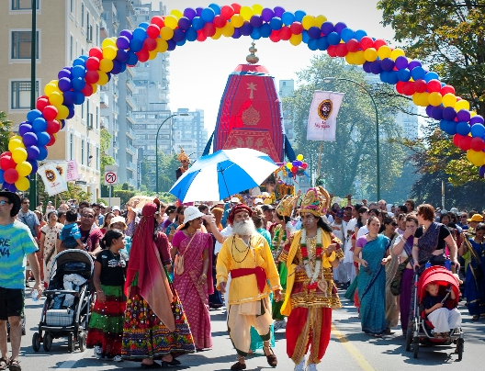
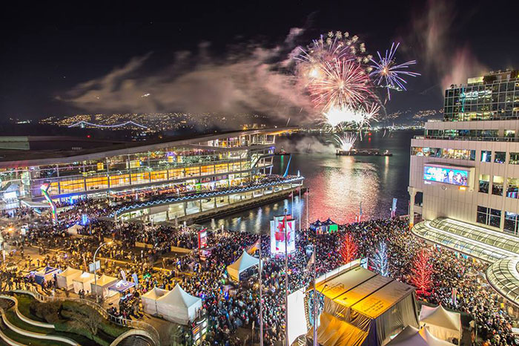
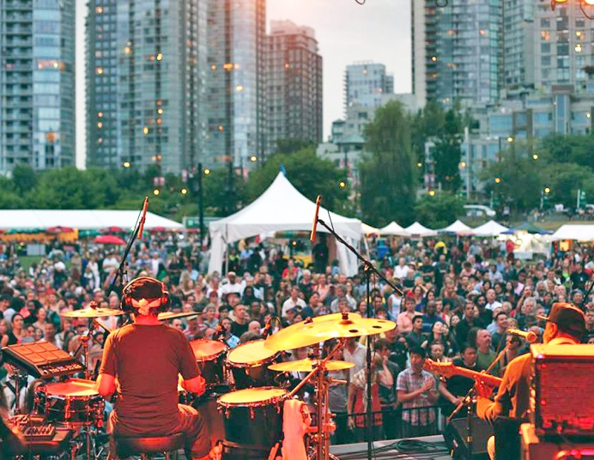
WHAT ARE SPECIAL EVENTS?
Specific rituals, presentations, performances or celebrations that are consciously planned and created to mark special occasions or achieve particular social, cultural or corporate goals and objectives.

Slide 3
SPECIAL EVENTS ARE BEST DEFINED BY THEIR CONTEXT
From the point of view of the event organizer: A special event is a one-time or infrequently occurring event outside normal programs or activities of the sponsoring or organizing body.
From the point of view of the customer or guest: To the customer or guest, a special event is an opportunity for a leisure, social or cultural experience outside the normal range of choices or beyond everyday experience.

Slide 4
WHAT CREATES AN EVENT ATMOSPHERE?
Festive spirit
Uniqueness
Quality
Authenticity
Tradition
Hospitality
Theme
Symbolism

Slide 5
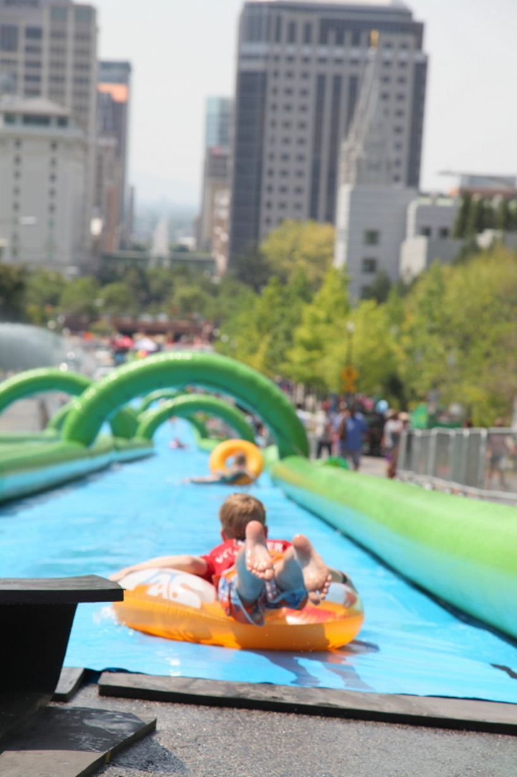
TYPES OF EVENTS
Two Categories:
Size
Mega Event
Hallmark Event
Major Event
Local/ community events
Form or Content
Festivals
Sports events
Business events
exhibitions

Slide 6
MEGA EVENT
So large they affect who economies and reverberate in the global media
Targeted at international tourism market
Considered mega due to:
attendance size,
target market
level of public financial involvement
political effects
extent of TV coverage
construction of facilities
Impact on economic and social fabric of the host community

Slide 7
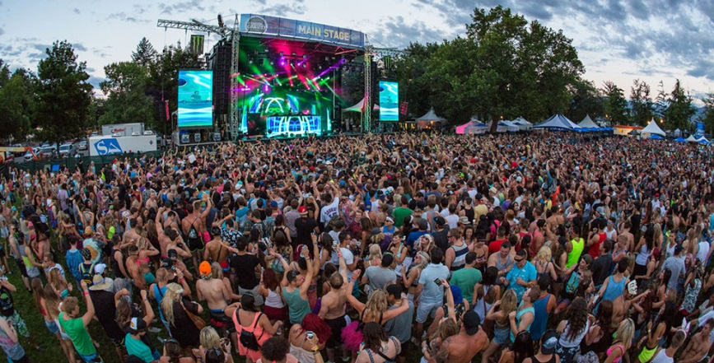
MEGA EVENTS

Slide 8
HALLMARK EVENTS
Events that become so identified with the spirit or ethos of a town, city or region that they become synonymous with the name of the place and gain widespread recognition and awareness
Major one-time or recurring events of limited duration developed to enhance awareness, appeal and profitability of a tourism destination in the short/ long term

Slide 9
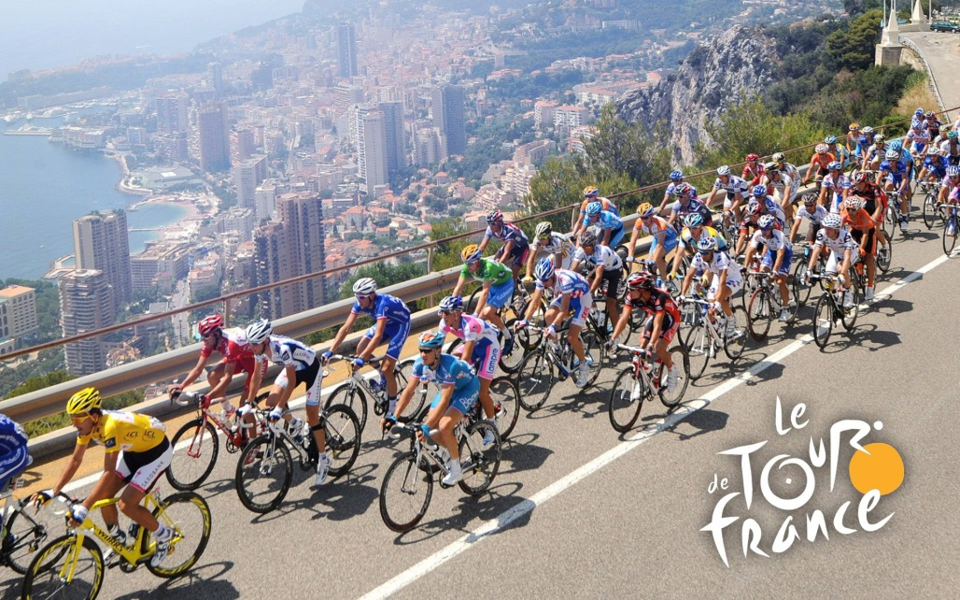
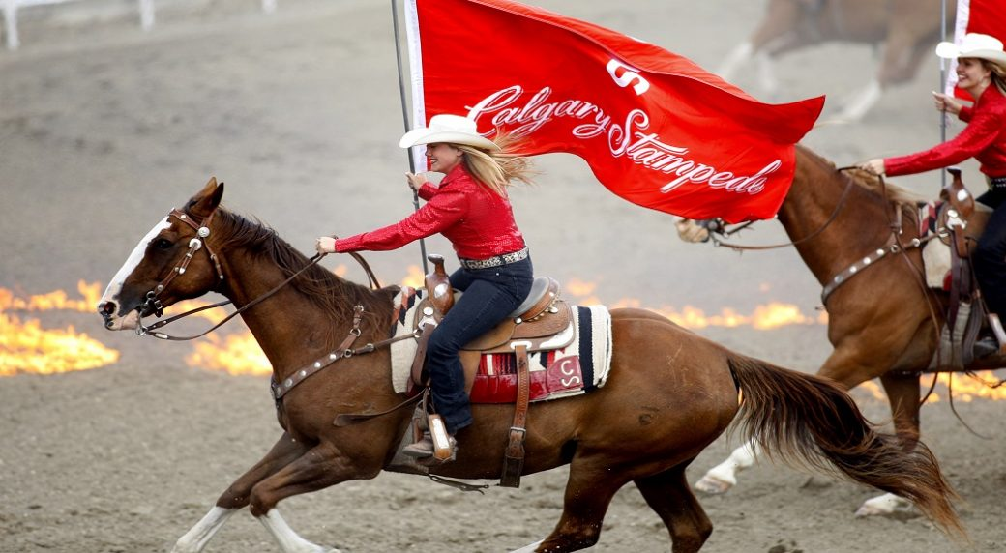
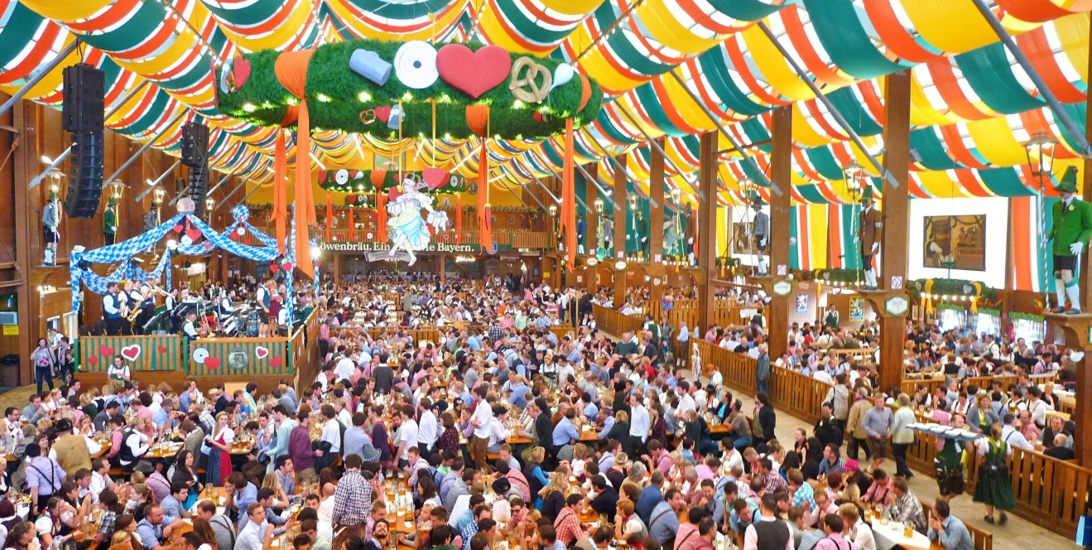
HALLMARK EVENTS

Slide 10
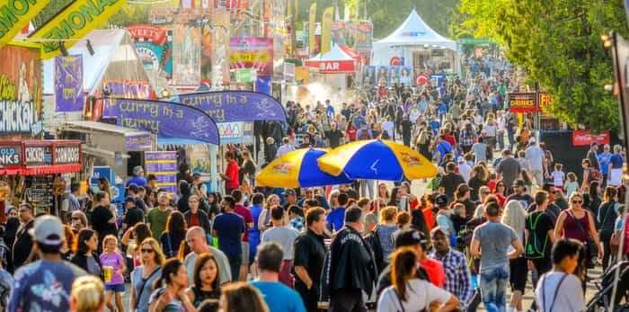
MAJOR EVENTS
Events that are capable by their scale and media interest of attracting significant visitor numbers, media coverage and economic benefits

Slide 11
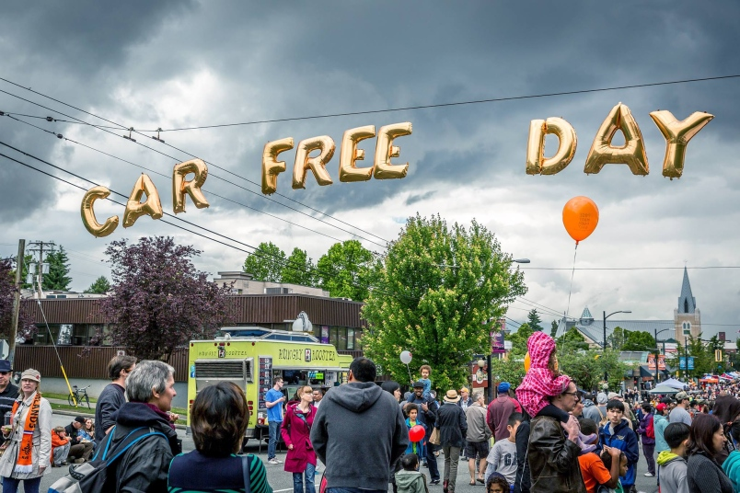
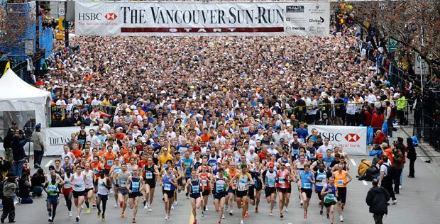
MAJOR EVENTS

Slide 12
LOCAL OR COMMUNITY EVENTS
Targeted to local audiences and staged primarily for their social, fun and entertainment value.
Produce a range or benefits including pride in community, strengthening a feeling of belonging and creating a sense of place.
Local governments often support these events as part of their community and cultural development strategies.

Slide 13
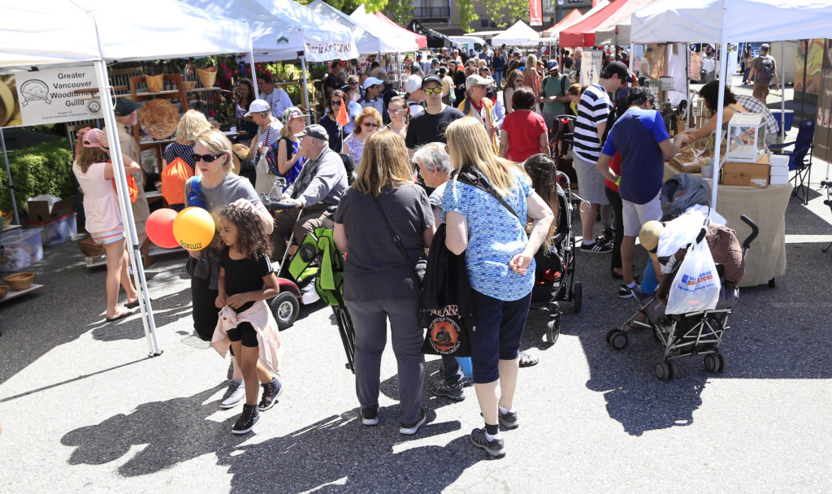
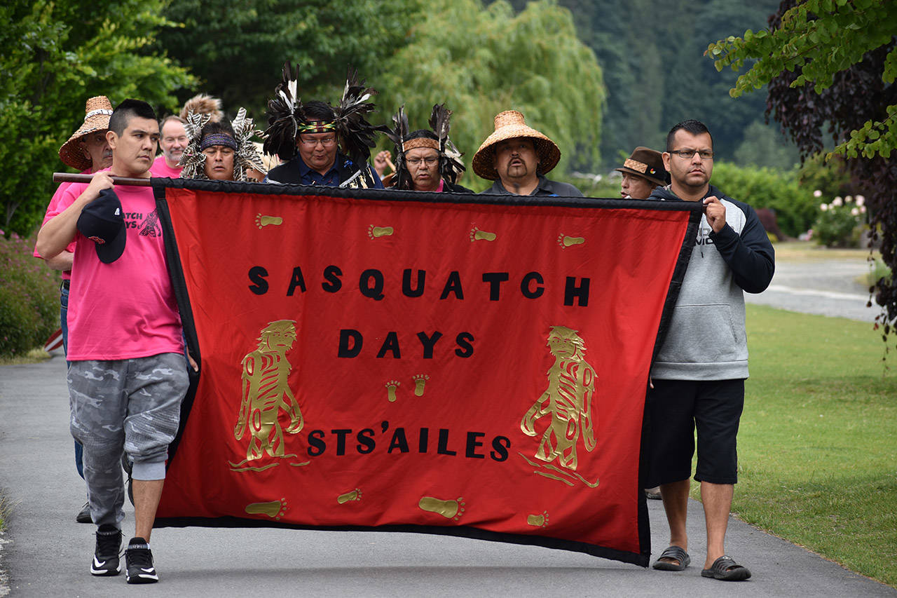
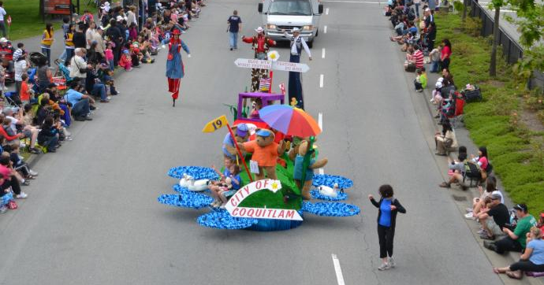
LOCAL OR COMMUNITY EVENTS

Slide 14
FORM OR CONTENT FESTIVALS
Important expression of human activity that contributes to our social and cultural life.
Increasingly linked with tourism to generate business activity and income for their host communities.

Slide 15
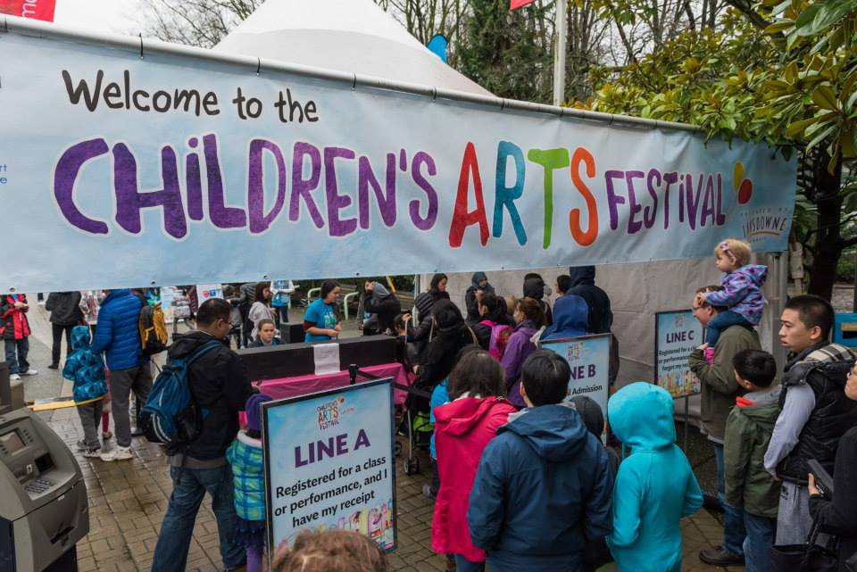
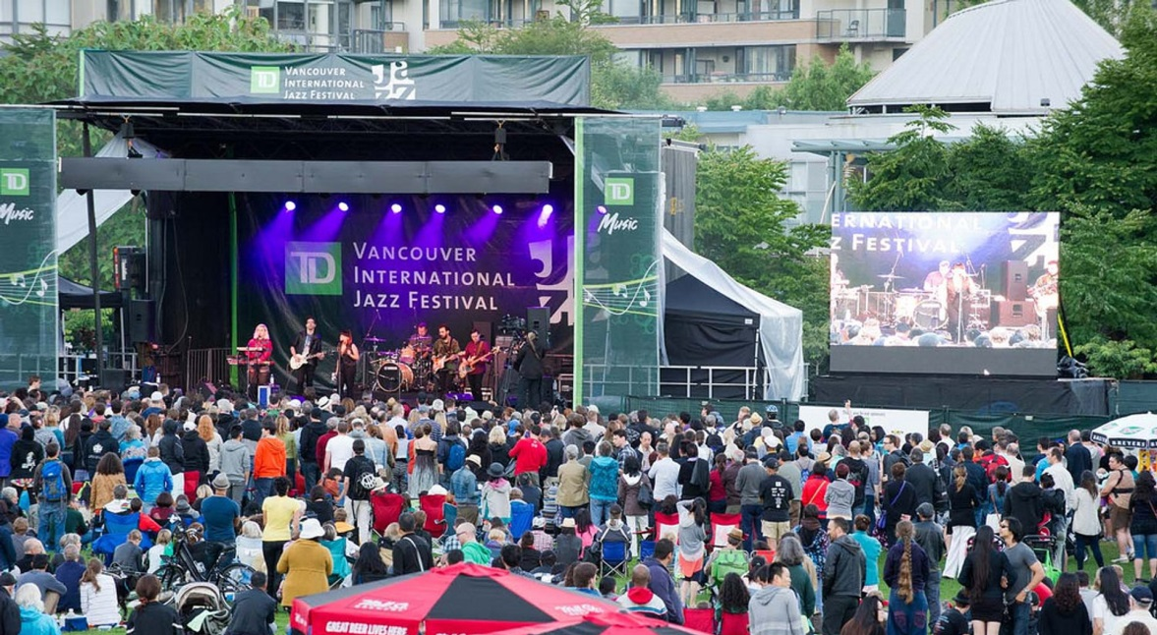
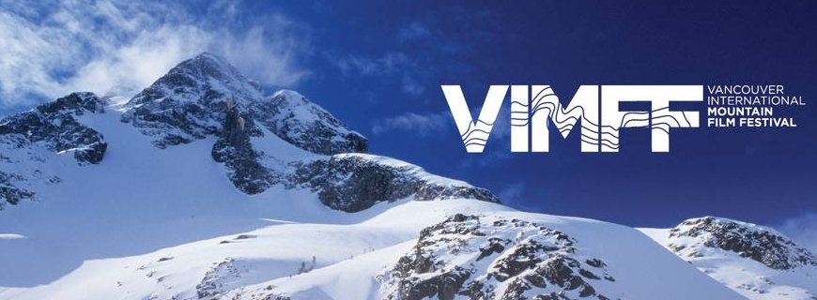
FESTIVALS

Slide 16
SPORTS EVENTS
Important and growing part of the event industry, encompassing the full spectrum of individual and multi sporting events
Ability to attract tourist visitors and to generate media coverage and economic impacts has placed them at the front of most government strategies and destination marketing programs.

Slide 17
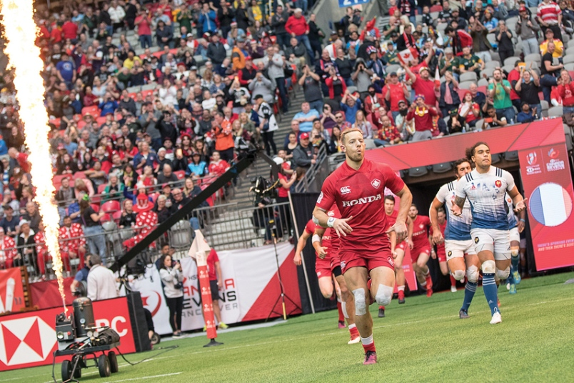
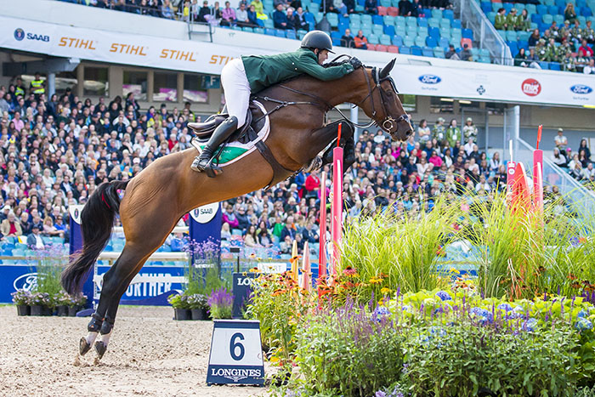
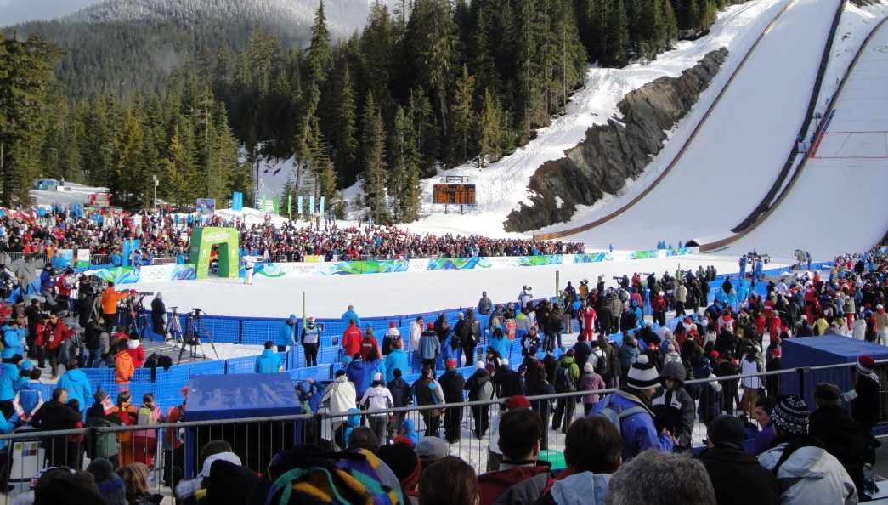
SPORTS EVENTS

Slide 18
BUSINESS EVENTS
All off-site gatherings, including conventions, congresses, conferences, seminars, workshops and symposiums, which bring together people for a common purpose – the sharing of information.
Includes exhibitions

Slide 19
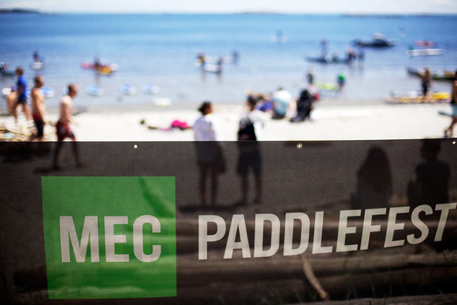
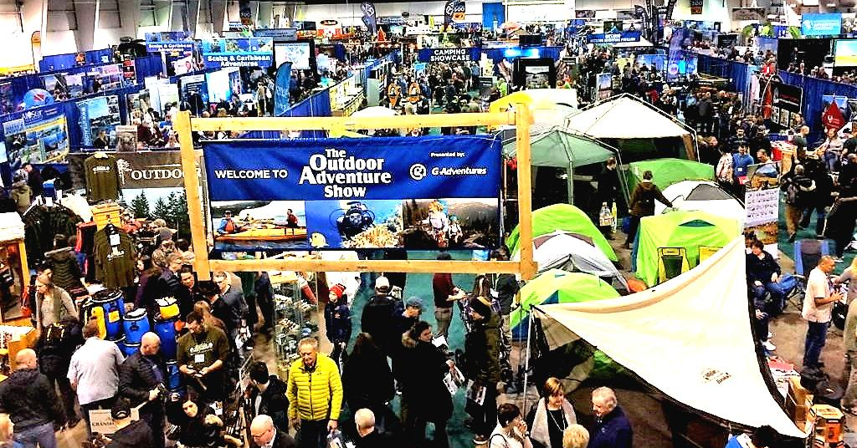
BUSINESS EVENTS AND EXHIBITIONS

Slide 20
REFERENCES:
Festival and Special Event Management Fifth Edition. by Johnny Allen, William O’Toole, Robert Harris, Ian McDonnell. Wiley and Sons. 2010.
Erin Wilkins, 2019.

